Slide 1
STOCK MARKET PREDICTION
Submitted By: Manushi Shashank

Slide 2
PROBLEM STATEMENT
Time Series forecasting & modelling plays an important role in data analysis. Time series analysis is a specialized branch of statistics used extensively in fields such as Econometrics & Operation Research. Time Series is being widely used in analytics & data science. Stock prices are volatile in nature and price depends on various factors. The main aim of this project is to predict stock prices using Long short term memory (LSTM).

Slide 3
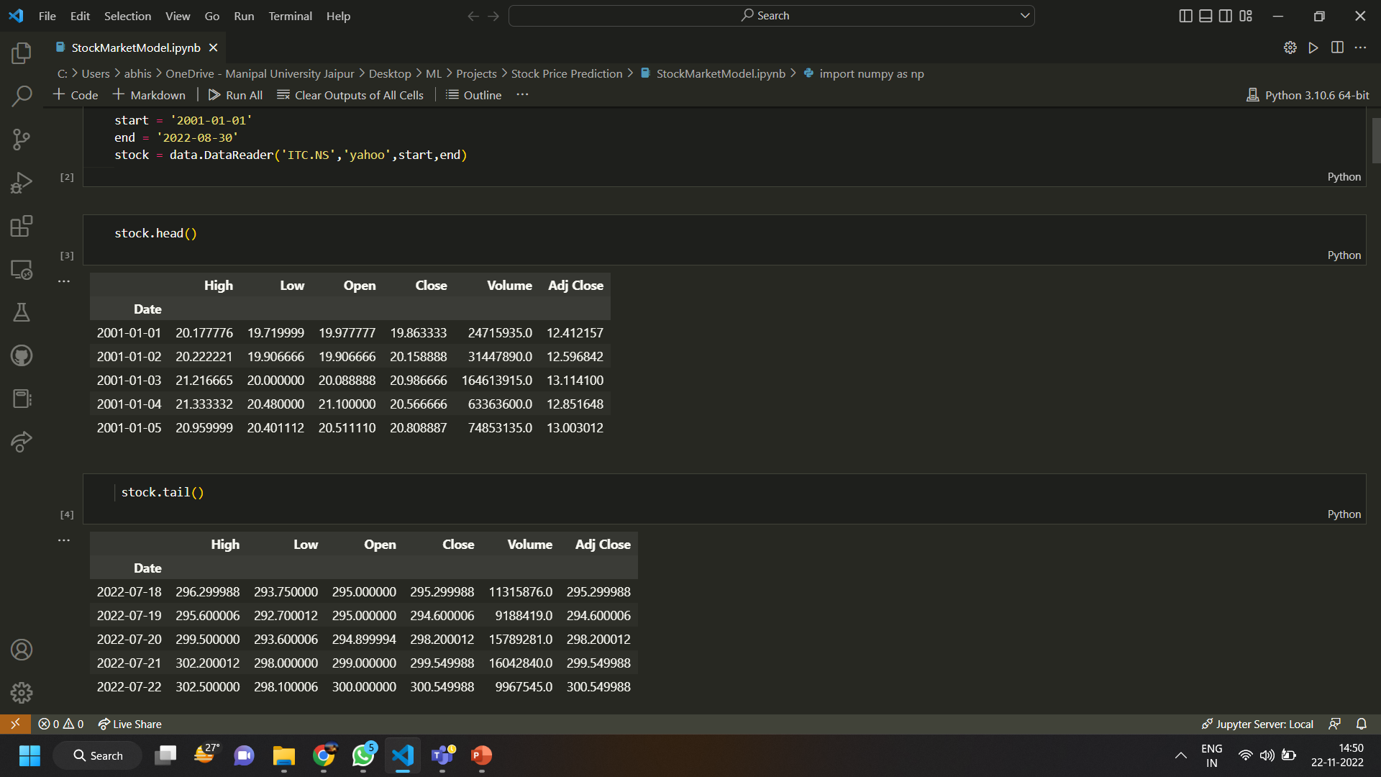
DATASET INFORMATION
Live Data from Yahoo Finance is being used as a dataset so that current day to day price can be added to the dataset and it can be used for future predictions.

Slide 4
CONCEPT
Here the concept of Moving Average is used. A moving average (MA) is a stock indicator commonly used in technical analysis, used to help smooth out price data by creating a constantly updated average price. A rising moving average indicates that the security is in an uptrend, while a declining moving average indicates a downtrend.
Two different values of moving average is being used here:
100 day moving average
200 day moving average

Slide 5
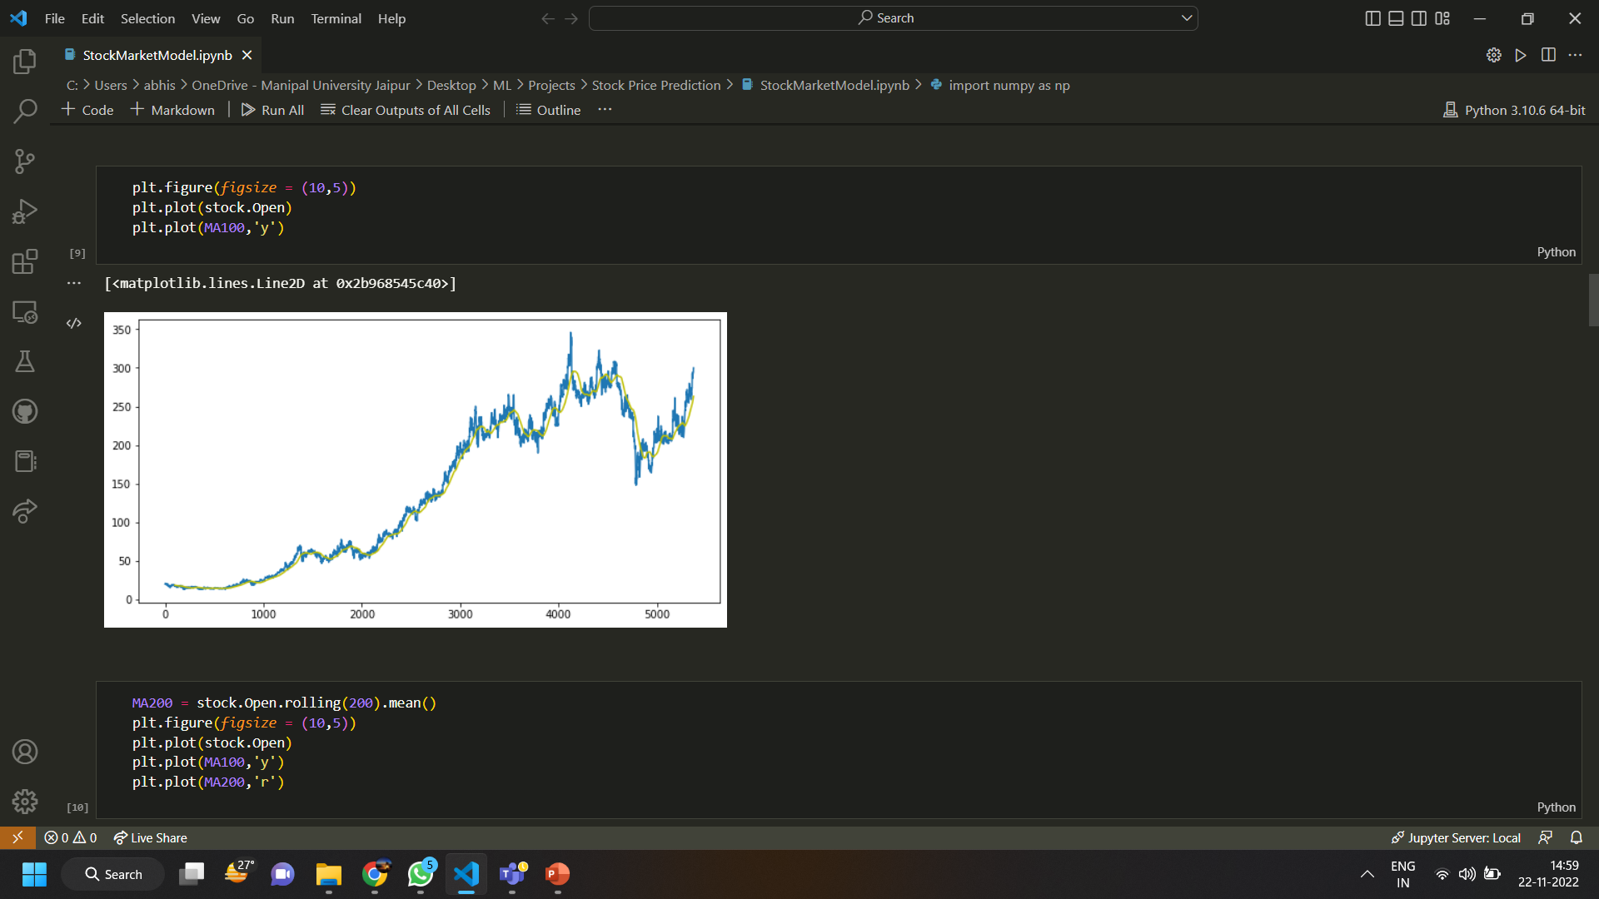
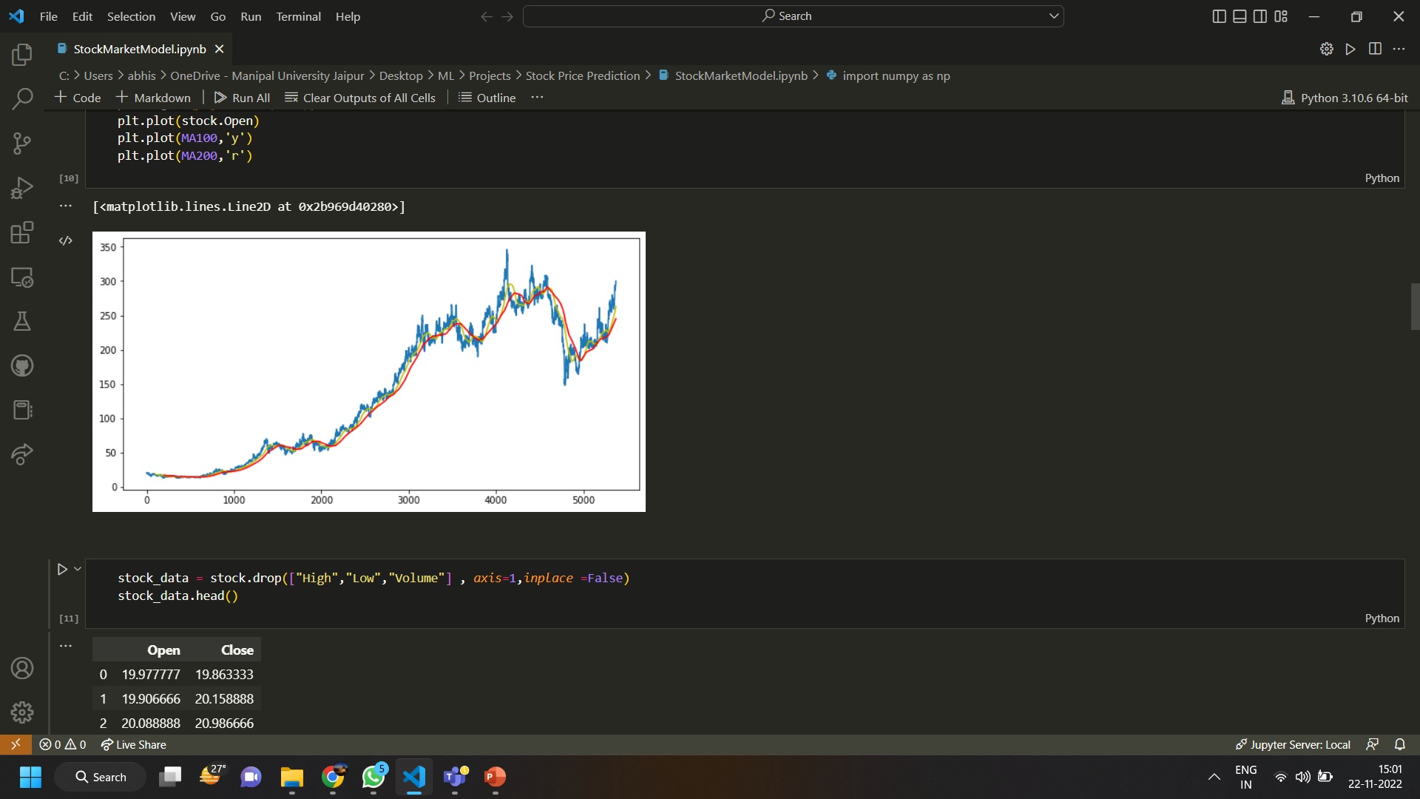
100 Day Moving Average Graph
200 Day Moving Average Graph

Slide 6
LONG SHORT TERM MEMORY(LSTM)
Long short-term memory (LSTM)is an artificial neural network used in the fields of artificial intelligence and deep learning. Unlike standard feedforward neural networks, LSTM has feedback connections. Such a recurrent neural network (RNN) can process not only single data points (such as images), but also entire sequences of data (such as speech or video).

Slide 7
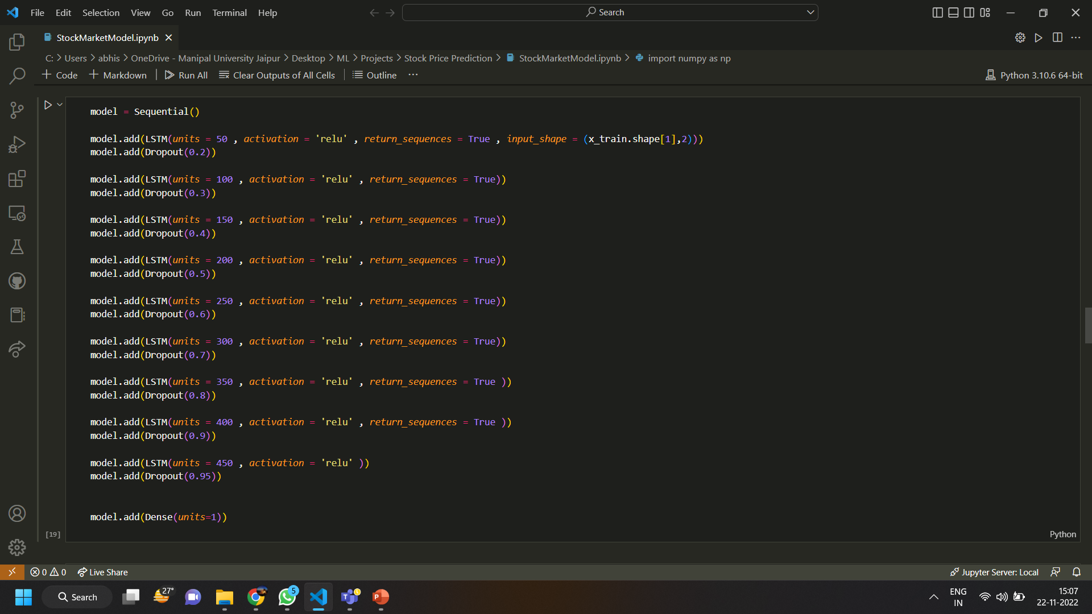
MODEL TRAINING

Slide 8
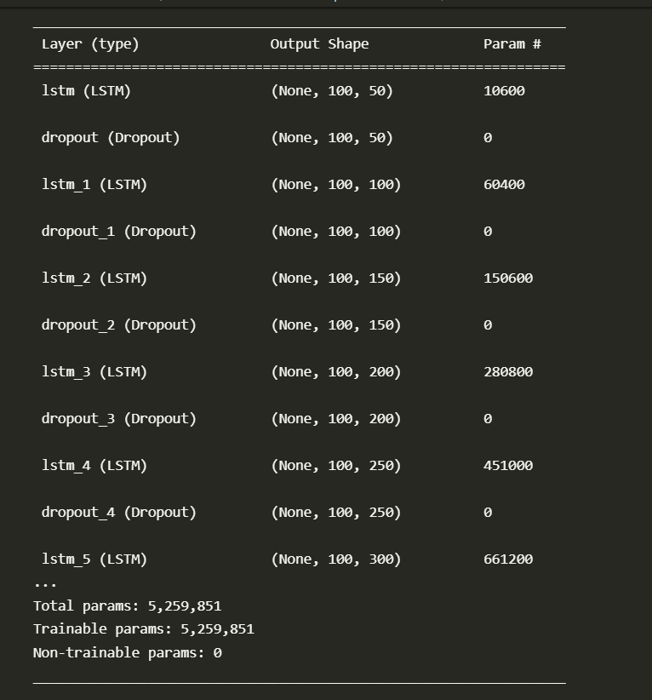
MODEL SUMMARY

Slide 9
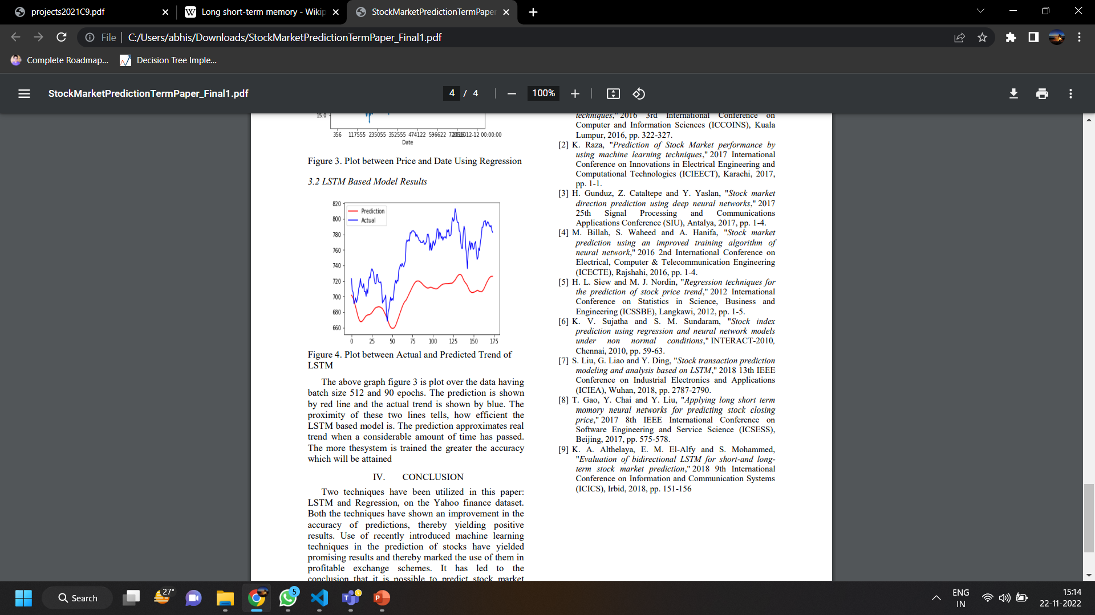
RESULT
The model was initially trained for 50 epochs.
The graph here shows the difference between Actual Price vs Predicted Price when the model was trained for 24 epochs.
The accuracy rate at 50 epochs is 91 percent.

Slide 10
Future Scope
This project can be made better if we add sentiment analysis to it as then the model will be able to understand the behaviour of stock on the market. As currently its working on previous data only.
This project can also modified to predict the Cryptocurrency Trading in Future.

Slide 11
REFRENCES
Stock Price Prediction Using LSTM on Indian Share Market by Achyut Ghosh, Soumik Bose1, GiridharMaji, Narayan C. Debnath, Soumya Sen
S. Selvin, R. Vinayakumar, E. A. Gopalkrishnan, V. K. Menon and K. P. Soman - Stock price predictionusing LSTM, RNN and CNN-sliding window model - 2017.

Slide 12
THANK YOU

